Slide 1


Setting up a Study Session

Slide 2
^{About IMM Graduate School}
The IMM Graduate School strives to be the private distance learning provider of choice and the centre of excellence for marketing, supply chain and business disciplines in Africa by offering fully accredited degrees, diplomas, certificates and postgraduate studies.

Slide 3


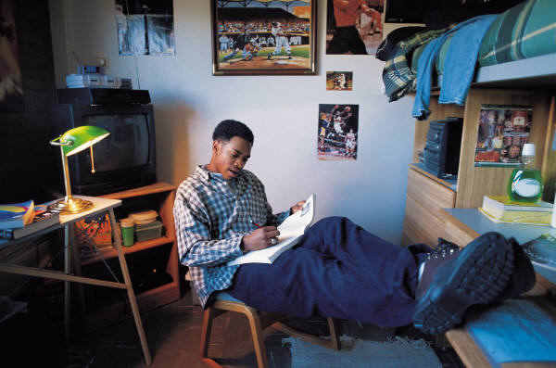
How do I arrange a study session?
Decide how much time you have to study.
Decide what you need to study in a session ahead of time, i.e. set goals for each section of work
Break up the session for each topic into several activities such as:
- Make and/or improve on existing notes
- Time for recall of information
- Practicing exam questions
- Working on assignment questions
- Reading and sourcing information
45 minutes study – 10 minutes
break – 45 minutes study

Slide 4
Managing a specific section of time
Revise in small chunks of time
– 40 minutes to 1 hour
Rest for 10 minutes (DON’T watch t.v. or read a magazine or phone a friend during this time!)
25 – 30 MINUTES
10
MINS
25 – 30 MINUTES
15 – 20
MINUTES
10
MINS
15 – 20
MINUTES
10
MINS
Difficult
work
Review
Difficult
work
Review

Slide 5
Motivation to stick to the session
TIP:
Use an egg timer, your cell phone alarm, or a clock and set the time so that it will ring when the session is over.
This provides you with more structure and you know you need to achieve your goals before the alarm goes off.
Be realistic about what you can do in the amount of time available
Avoid a random approach – make sure you plan a session by having a realistic goal, managing the time in the session, remaining focused and reflecting on your successful use of time
Make sure you study actively – questioning, making notes

